Slide 1
Keeping Families Together Act Effective July 1, 2023
Quarterly Data Update
July 2024

Slide 2
What we’re seeing:
The law is meeting the intended impact of reducing removals
We are not removing many children at high risk, and those children are with their families and communities.
Internal reviews of Safe Child Consultations indicate that we are taking additional steps to prevent removal of a child and to support a safety plan for the family
The overlap between 1227 and Plan of Safe Care is reducing screened in intakes involving substance-exposed newborns
Fentanyl crisis leaves many children at risk
A lack of SUD treatment services and other community-based supports for families places children at further risk

Slide 3
Long-term trends:
Between state fiscal year (SFY) 2018 and the implementation of HB1227 at the end of SFY2023, Washington saw a 35.6% decrease in the number of children in out of home care (point in time). This trend is largely consistent with the national trends on children in out of home care.
Since 2020, DCYF has seen an increasing percentage of moderately high to high-risk cases being re-referred to CPS intake and screening-in (within 90 days of the completion of the risk assessment.)
Since 2019, opioid-related emergencies have dramatically increased for the entire population (both adults and children) in Washington.

Slide 4
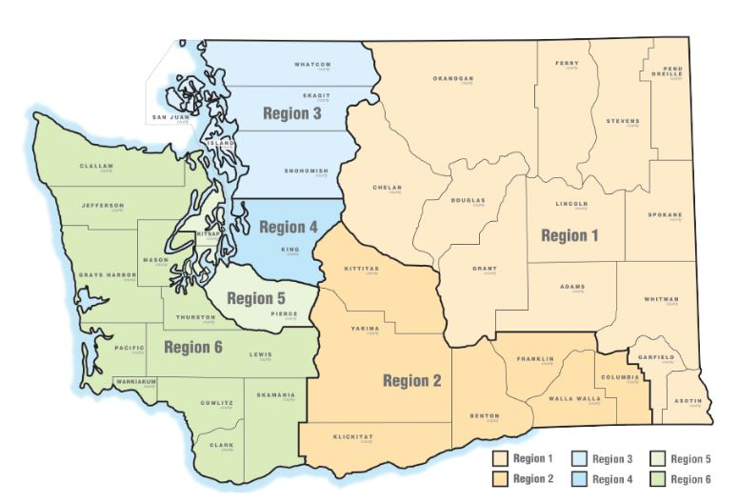
Entries into care have decreased by 14.2% since the new law went into effect SFY2023 compared to SFY2024 Count and Percentage Change in Children Entering Care by Original Region, July 1- June 30
Statewide:
14.2% reduction in children entering care
Largest reductions remain in Clark, Spokane, and Yakima Counties
¹2024 estimate adjusted for known data lag, observed 2024 count=2,800
DCYF OIAA (July 2024). CW Reporting Portal,
Out of Home Exits and Entries
[July 2022-June 2024].

Slide 5
Entries into care are down across all categories, while participation in Family Voluntary Services has increased by 10%
 | All entries into care
 | July 1, 2022- June 30, 2023 | July 1, 2023-June 30, 2024*
Voluntary Placements | 544 | 497
Protective Custodies | 1,652 | 1,565
Court Approved Placements | 1,108 | 709
*2023/24 data are observed, not adjusted for known data lag, so may increase somewhat as more case data are entered into FamLink
 | Cases receiving services
Family Voluntary Services | 1,809 | 1,994
** Family Voluntary Services identifies the distinct count of families served by FVS during the time frame identified
DCYF OIAA (July 2024). CW Reporting Portal,
Out of Home Exits and Entries and CW Assignment Report
[July 2022-June 2024]

Slide 6
The largest reductions in out of home placements are among infants
Total Fewer Children Entering Care by Age Group
July 1, 2022 – June 30, 2023, compared to July 1, 2023 – June 30, 2024
 | Number | Percentage
Age 0-1 | -229 | -20.8%
Age 2-3 | -30 | -7.5%
Age 4-11 | -104 | -9.4%
Age 12-17 | -126 | -18.4%
Observed, not adjusted for data lag
DCYF OIAA (July 2024), CW Reporting Portal,
Out of Home Exits and Entries
[July 2022-June 2024]

Slide 7
*As of July 2024, there have been 18 critical incidences that have been identified as fentanyl/opioid related
DCYF PPS (July 2024),
Administrative Incident Reporting and Fatality Reviews
[Jan 2019-2024]
Notes:
Key takeaway: fentanyl-related critical incidents are increasing among children in Washington State and having a growing impact on the child welfare system.

