Slide 1
The Fair Start For Kids Act 2023 Evaluation
March 29th, 2024
OIAA Evaluation and Research
The Department of Children, Youth & Families’ Office of Innovation, Alignment, and Accountability (OIAA) builds the agency’s capacity to make evidence-informed decisions, continuously learn and improve, and successfully enact system reform

Slide 2
Background
The Fair Start for Kids Act (FSKA) is historic legislation signed by Governor Inslee on May 7, 2021.
Washington State invested $1.1 billion to expand access to affordable, high-quality early learning and child care for Washington families and to stabilize the child care and early learning workforce.
Four policy objectives:
  Advance racial equity
  Expand access to affordable child care and early learning
  Promote kindergarten readiness
  Support the child care and early learning workforce
SB 5237 (2021): “[DCYF]…shall submit a biennial report to the governor and legislature describing how the investments funded by the fair start for kids act have impacted the policy objectives”. – Section 104 (3)

Slide 3
Equity

Slide 4
Child Care Expulsions
Preliminary Disproportionality Ratio in Reported Expulsions from Child Care, Age 0-5, 2018-2022
Finding: Decreased child care expulsion disproportionalities for BIPOC children after 2020
Data source: Ratio numerator from WaCompass provider reports; Ratio denominator from Census Bureau American Community Survey
WSRDAC/M: No. Black, Indigenous, and people of color (BIPOC) category includes AI/AN, Black, Asian, NH/PI, and Hispanic. Small sample sizes prevents reporting these groups separately.
Chart source: DCYF 2023 Equity Metric Report

Slide 5
Access

Slide 6
Entry and Exit Rates for Family Child Care Homes , Statewide 2019-2022
Child Care Provider Churn
Total providers by facility type, 2019-2022
Entry and Exit Rates for Child Care Centers, Statewide 2019-2022
Data source: WaCompass, July 2023
6

Slide 7
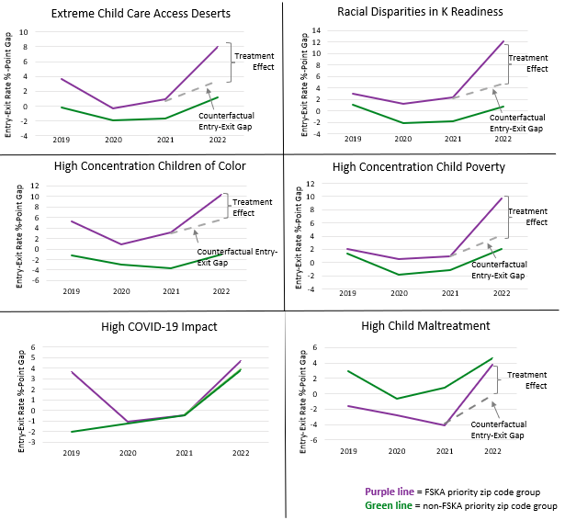
Child Care Provider Churn
Difference-in-Difference Analysis of Provider Entry-Exit Rate Gaps in Priority Zip Code Groups Statewide, 2019-2022
Finding: Higher provider entries than exits in all FSKA priority zip code areas
Data source: DCYF Child Care Licensing Data
7

Slide 8
Kindergarten Readiness

Slide 9
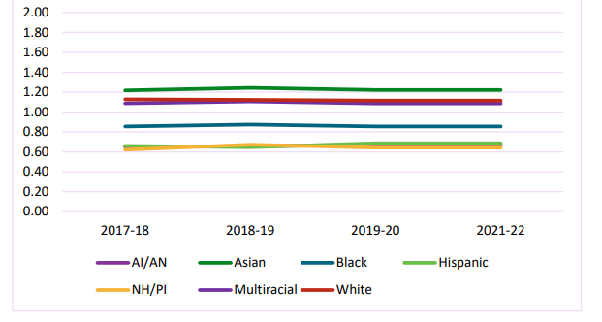
Kindergarten Readiness
Disparity Ratio – Entering Kindergarteners Ready on Six of Six WaKIDS Domains by Race/Ethnicity (2017-21 SYs; excludes 2020-21 SY)
Finding: FSKA funding appears to have little impact on kindergarten readiness at this time
Data source: 2021-22 OSPI Kindergarten Readiness Report Card

Slide 10
Workforce Stabilization

Slide 11
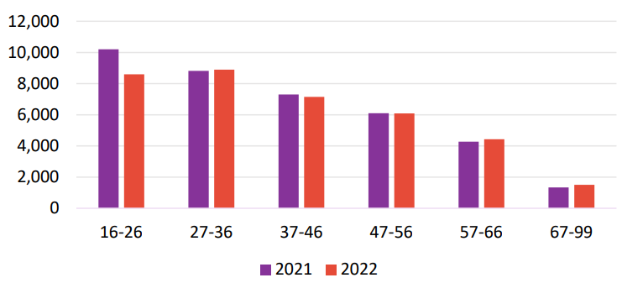
Worker Turnover
Findings:
Child care and early learning linked MERIT workforce counts by age group, 2021-2022
Outcome | Race/ Ethnicity | Language | Age | Position | Facility
Increase | White | English | -- | Aide or Teacher | Child Care Center
Decrease | Black, Asian, Hispanic | Spanish | 16-20 | -- | --

Slide 12
Conclusion
Overall, strong evidence that FSKA investments helped stabilize licensed child care system in WA
Next FSKA evaluation report anticipated due date: September 2025
  Expulsions in child care
  Access to care (e.g., child care continuity)
  Kindergarten readiness
  Provider entry and exits
  Child care and early learning workforce turnover
OIAA will produce supplemental analyses during interim periods available on the DCYF website

Slide 13
Thank you!
Contact:
OIAA@dcyf.wa.gov
https://www.dcyf.wa.gov/sites/default/files/pdf/reports/FSKA-EvalReport-2023.pdf
Suggested citation: Budrevich-Ryan, A., Ybarra, V., Seppi, J., Lothian, K., J. and Feldman, S. (2023). The Fair Start for Kids Act 2023 Evaluation Report. Washington State Department of Children, Youth, and Families – Office of Innovation, Alignment, and Accountability.

