Slide 1
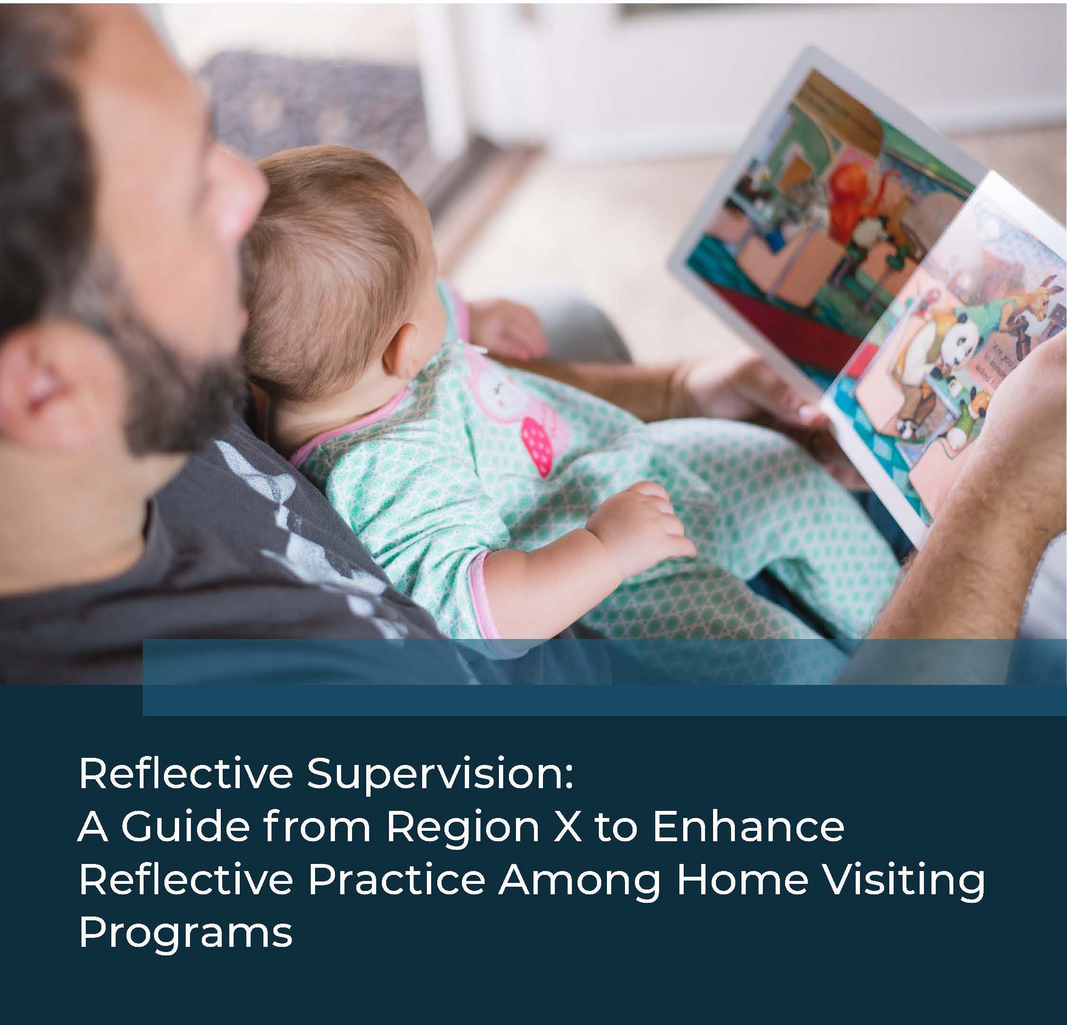
https://www.wa-aimh.org/rs-guidelines-project
Reflective Supervision: A Guide, 2018

Slide 2
Reflective Supervision: A Guide, 2018

Slide 3
The Reflective Supervision Guide was developed as one part of a much
larger MIECHV Innovation grant awarded to HRSA Region X.
This Region X Project was 100% funded by the Health Resources and
Services Administration (HRSA) of the US Department of Health and
Human Services (HHS) under the Maternal Infant and Early Childhood
Home Visiting Program, #UH4MC30465, total award of $3,957,620.00.
This information or content and conclusions are those of the author
and should not be construed as the official position or policy of, nor
should any endorsements be inferred by HRSA, HHS, or the US
Government.
Reflective Supervision: A Guide, 2018

Slide 4
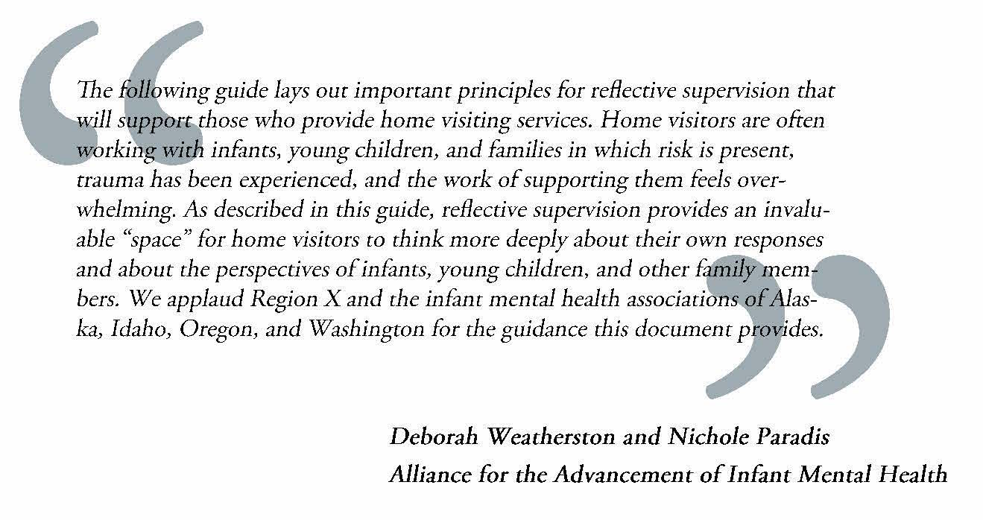
Reflective Supervision: A Guide, 2018

Slide 5
MI-AIMH, 2017©

Slide 6
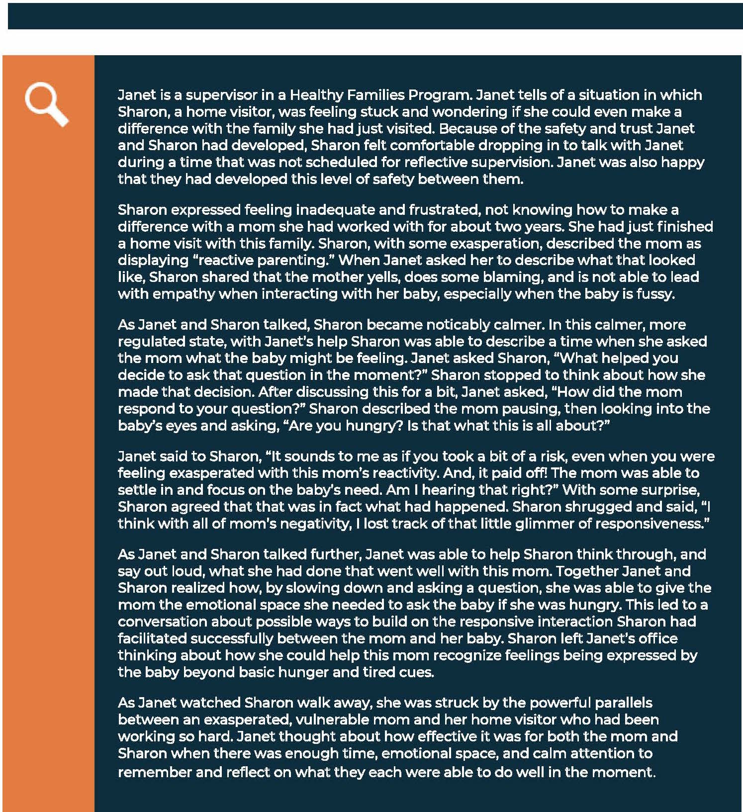
Reflective Supervision: A Guide, 2018
Reflective Supervision: A Guide, 2018

Slide 7
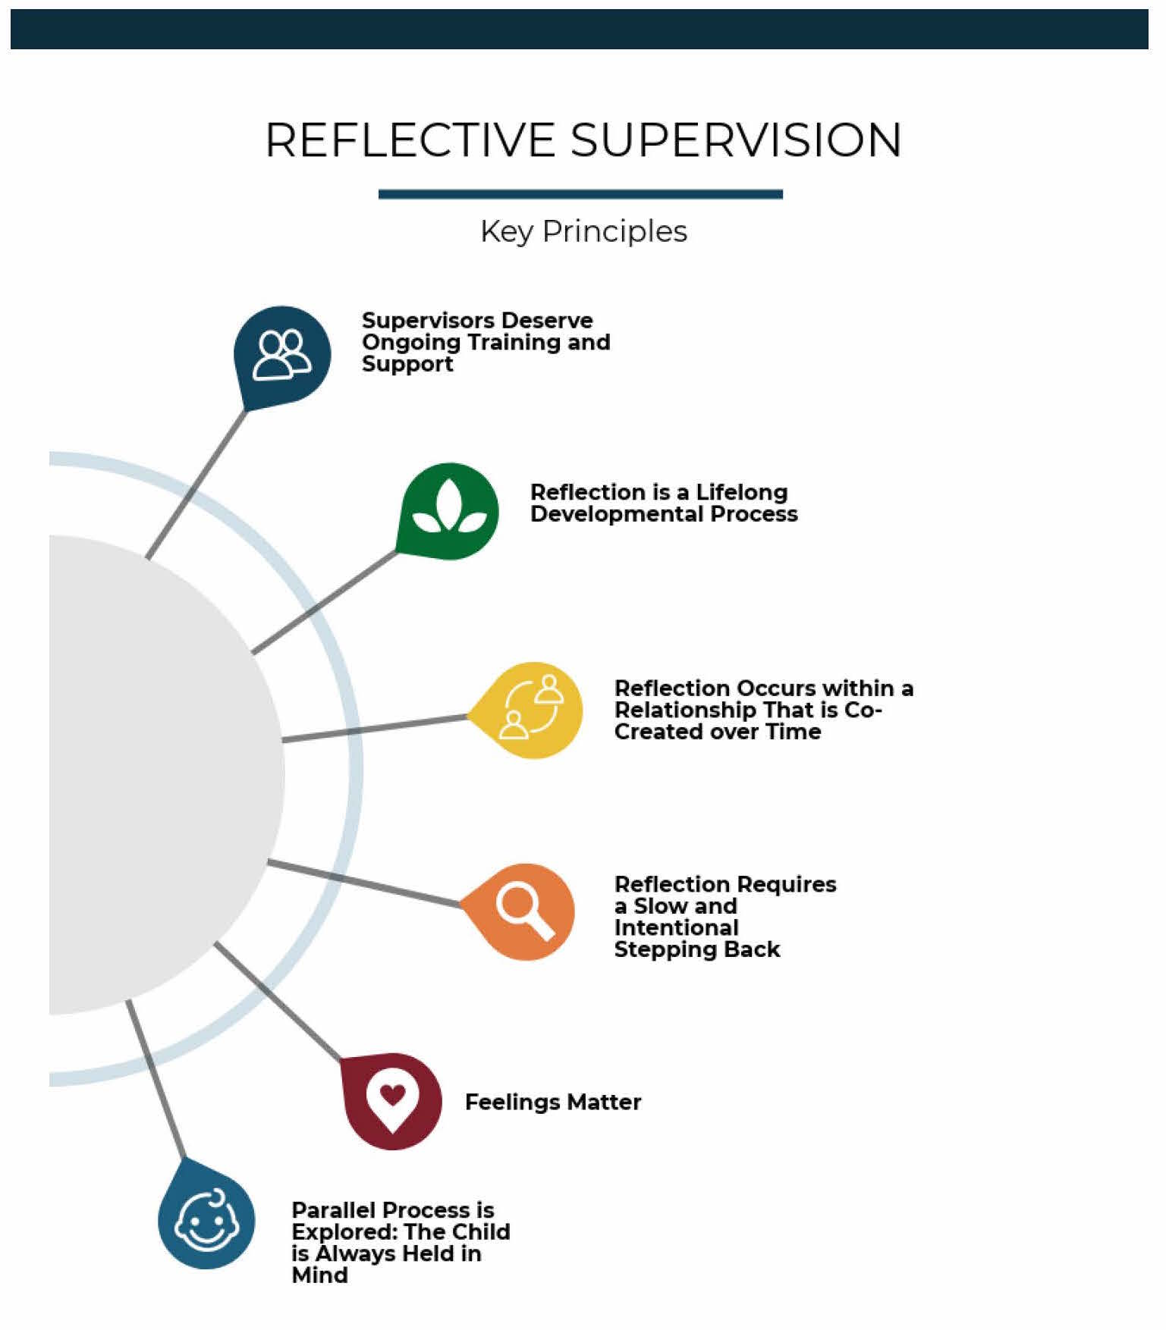
Reflective Supervision: A Guide, 2018

Slide 8
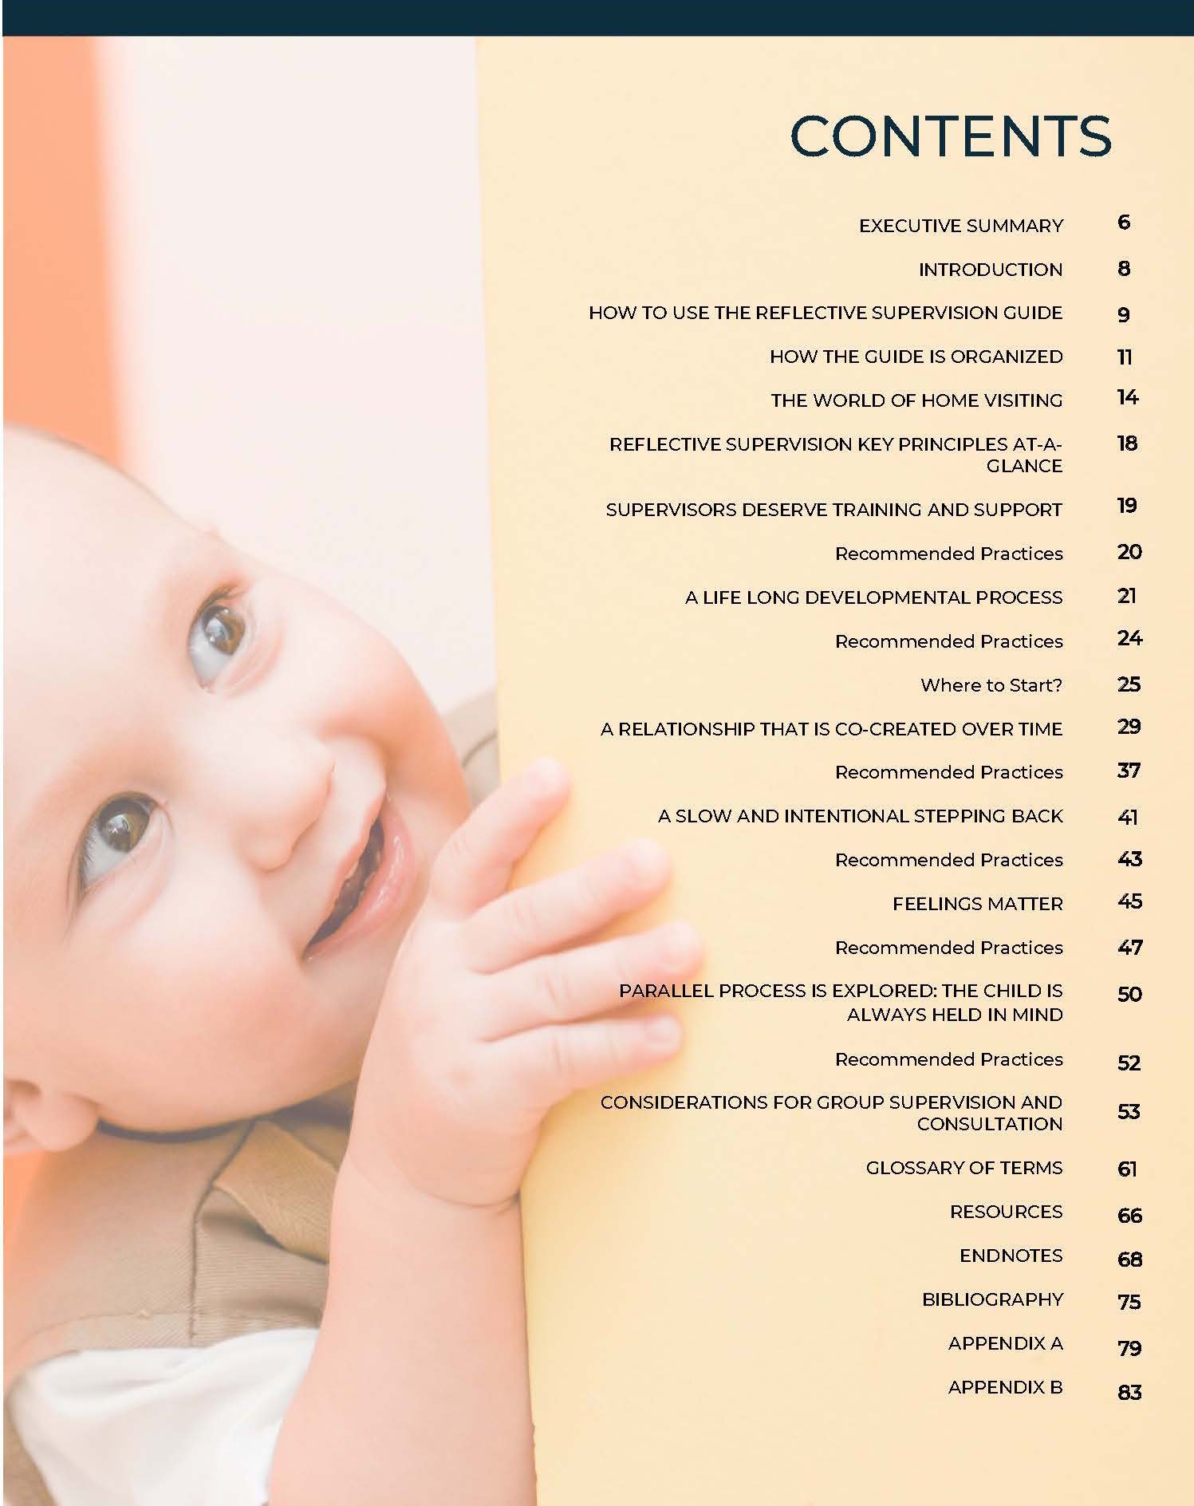
Reflective Supervision: A Guide, 2018

Slide 9
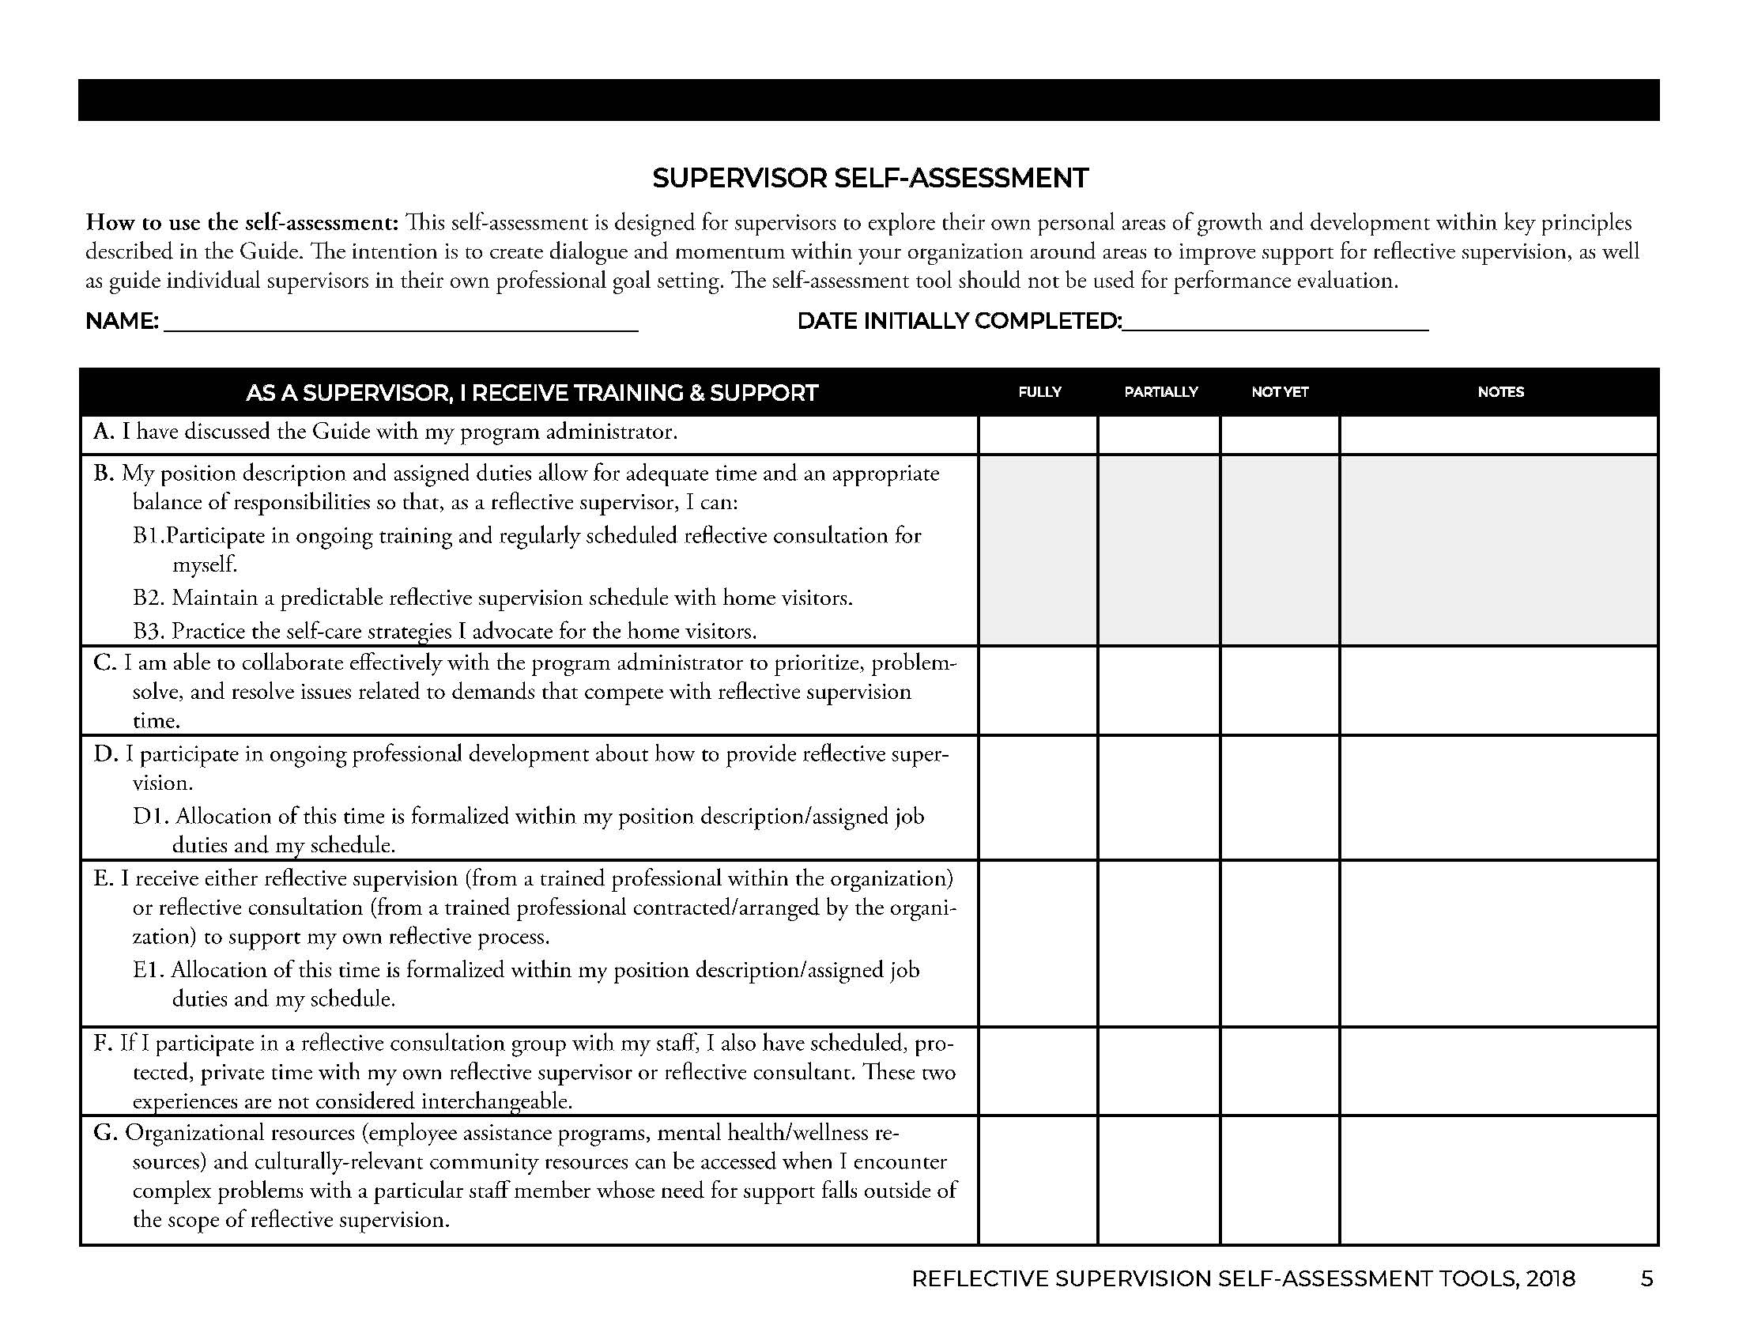
Reflective Supervision: A Guide, Self-Assessment Tools, 2018

Slide 10
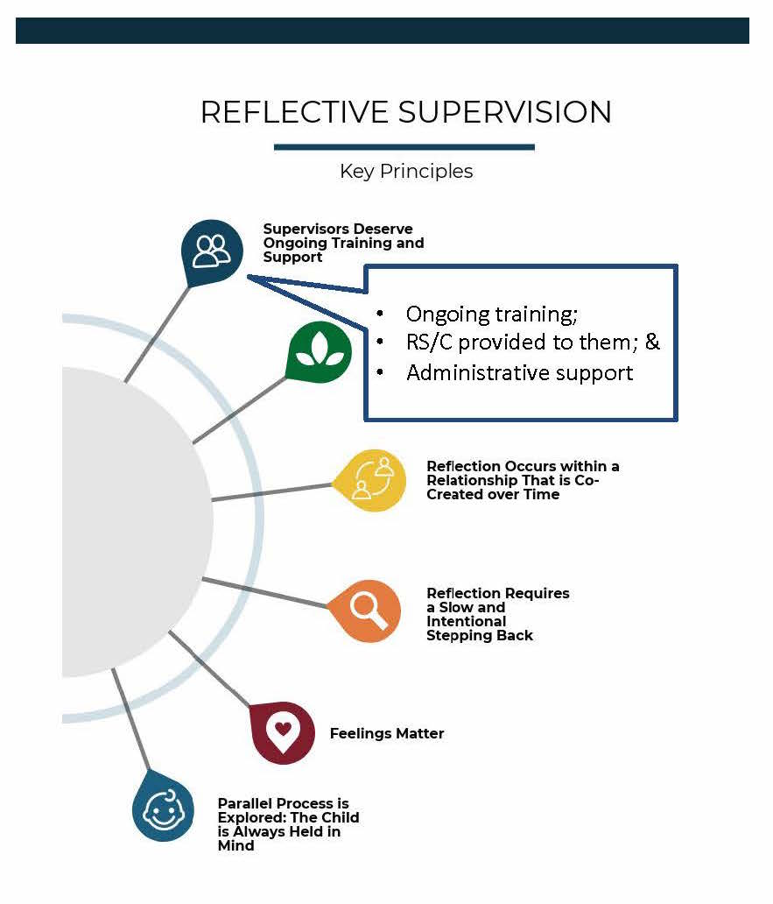
Reflective Supervision: A Guide, 2018

Slide 11
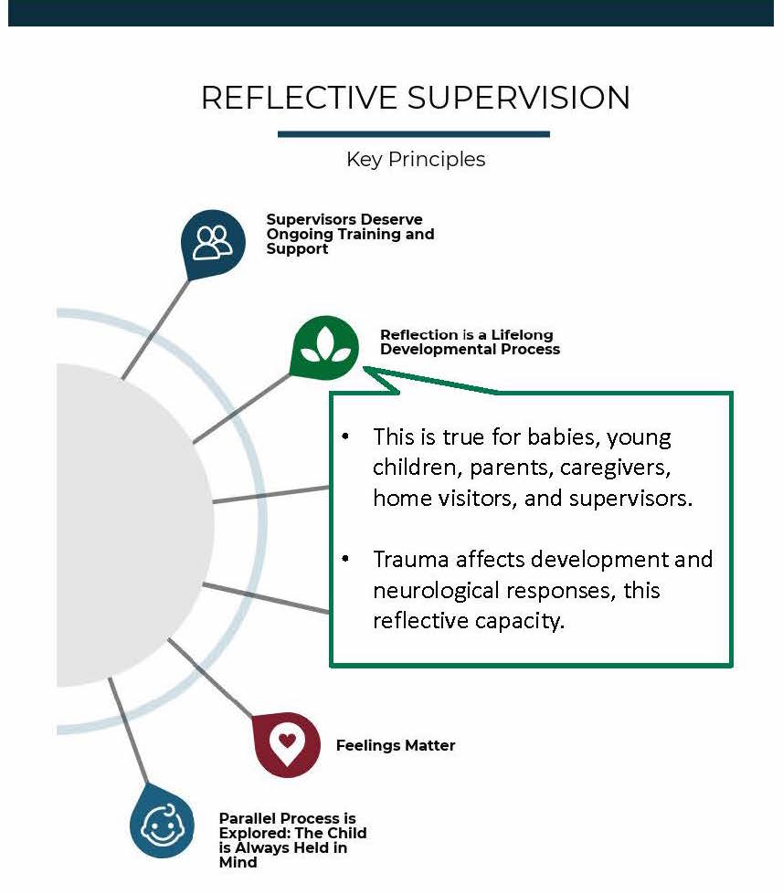
Reflective Supervision: A Guide, 2018

Slide 12
Reflective Supervision: A Guide, 2018

Slide 13
Reflective Supervision: A Guide, 2018

Slide 14
Reflective Supervision: A Guide, 2018

Slide 15
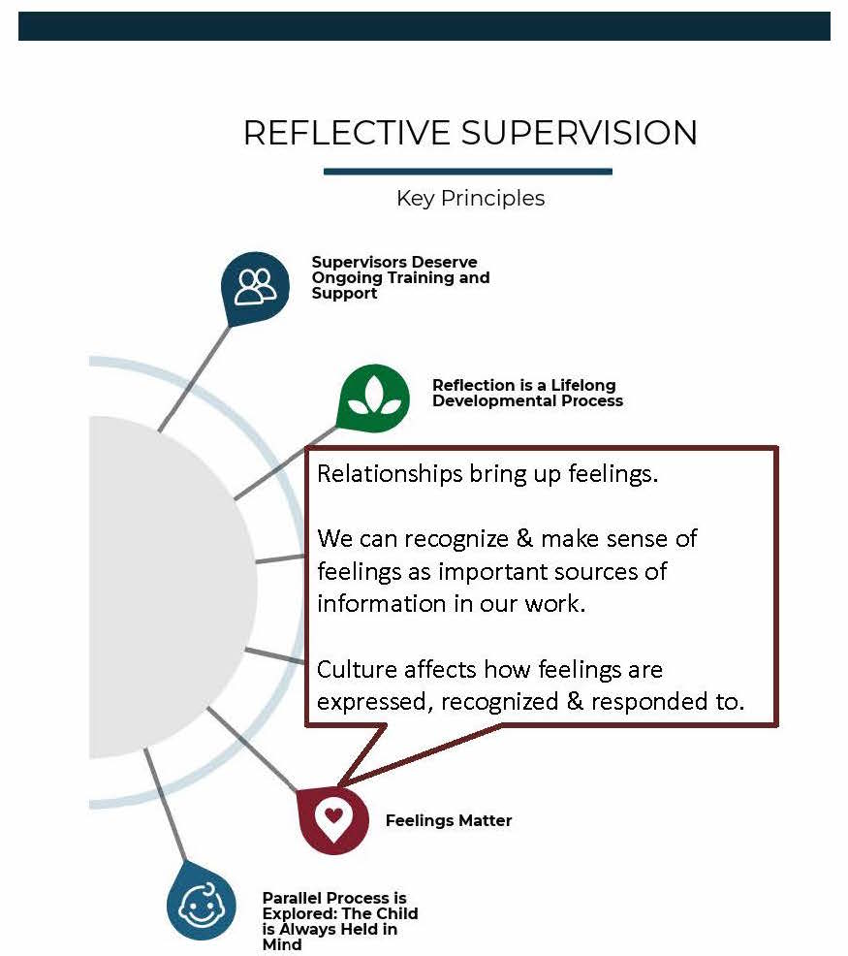
Reflective Supervision: A Guide, 2018

Slide 16
Feelings
Matter
Reflective Supervision: A Guide, 2018

Slide 17
Reflective Supervision: A Guide, 2018

Slide 19
https://www.wa-aimh.org/rs-guidelines-project
Reflective Supervision: A Guide, 2018

