Slide 1
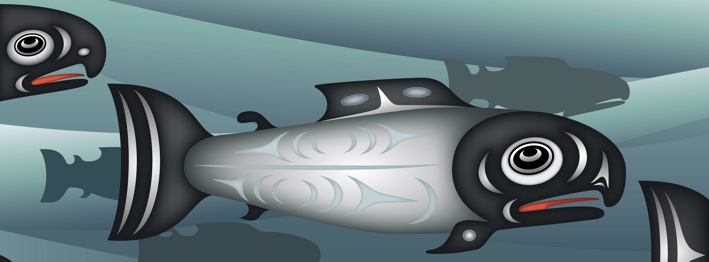
John McCoy (lulilaš) Since Time Immemorial: Tribal Sovereignty Early Learning Curriculum
Print provided by Qwalsius Shaun Peterson, Puyallup
Developed in collaboration with:
First Peoples First Steps Alliance
Thrive Washington
Department of Early Learning Native American Early Learning Project – Puget Sound ESD
OSPI Office of Native Education

Slide 2
Training Outcomes
Desirable outcomes for early learning educators:
Understand the requirements of SB5433
Gain a basic understanding of tribal sovereignty
Know the structure and resources of the STI Early Learning lessons
Prepare for implementation of the STI Early Learning lessons

Slide 3
Bingo instructions
Pull out the bingo card in your folder pocket. You will walk around the room to find someone with the correct answer to a question in your bingo squares. You will give answers as participants ask you the questions too.
Sign your name in the center square
Sign only one square for another person
Going for a blackout, but call out when you have a BINGO in any direction
Learn as you go

Slide 4
Concepts of tribal sovereignty
“The ability of tribes to govern themselves and continue their lifeways.”
- 4th grade “Tribal Homelands” unit, “On Sovereignty” written by Carol Craig (Yakama) and Shana Brown (Yakama descendent)
“American Indian Tribes are recognized in federal law as possessing sovereignty over their members and territory. Sovereignty means that tribes have the power to make and enforce laws, and to establish courts and other forums for resolution of disputes. The sovereignty that American Indian Tribes possess is inherent which means that it comes from within the tribe itself and existed before the establishment of the United States government. Tribal sovereignty is further defined by the unique relationship of the tribes to the United States. In addition to inherent sovereignty, tribal governments may also exercise authority delegated to them by Congress.”
- 2006 Tribal Leaders Congress MOU

Slide 5
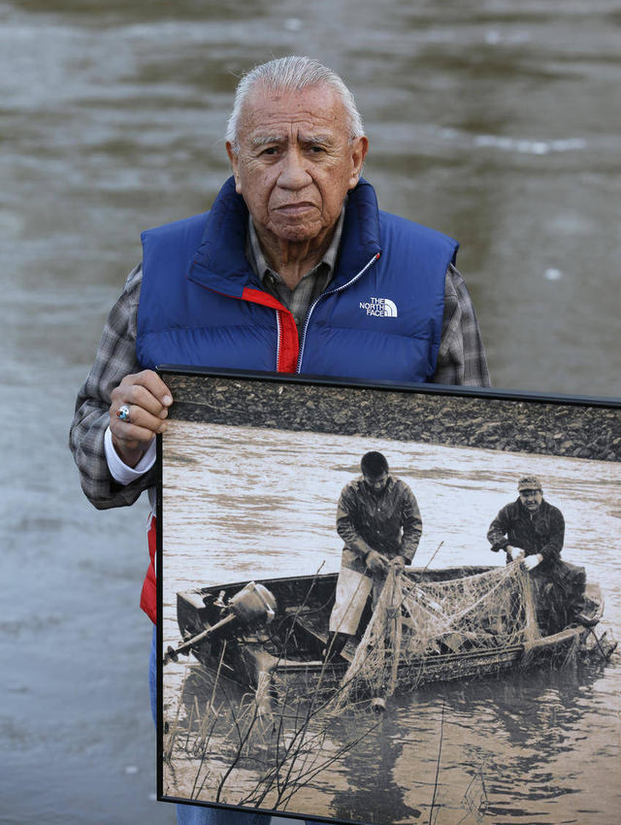
Sovereignty affects
Indigenous Language
Education
Environmental Protection and Land
Healthcare
Courts & Judicial system - including civil and criminal jurisdiction
Taxation
Economic Development
Nation to Nation or government relations
Quality of life
Decolonization

Slide 6
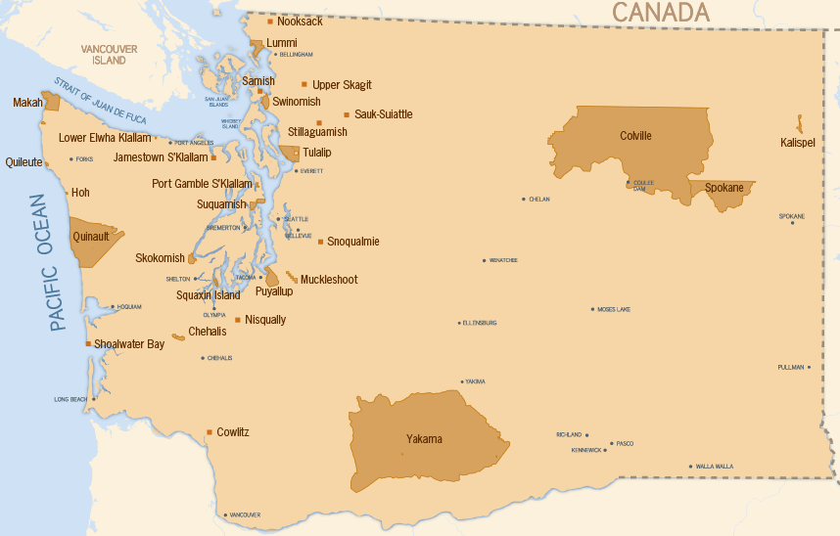
Tribes of Washington state
Colville Confederated Tribes
Confederated Tribes of Chehalis
Confederated Tribes of Yakama
Cowlitz
Hoh
Jamestown S’Klallam
Kalispel
Lower Elwa Klallam
Lummi
Makah
Muckleshoot
Nisqually
Nooksack
Port Gamble S’Klallam
Puyallup
Quileute
Quinault
Samish
Sauk-Suiattle
Shoalwater Bay
Skokomish
Snoqualmie
Spokane
Squaxin Island
Stillaguamish
Suquamish
Swinomish
Tulalip Tribes
Upper Skagit
http://www.washingtontribes.org/default.aspx?ID=2

Slide 7
- From Where The Sun Rises

Slide 8
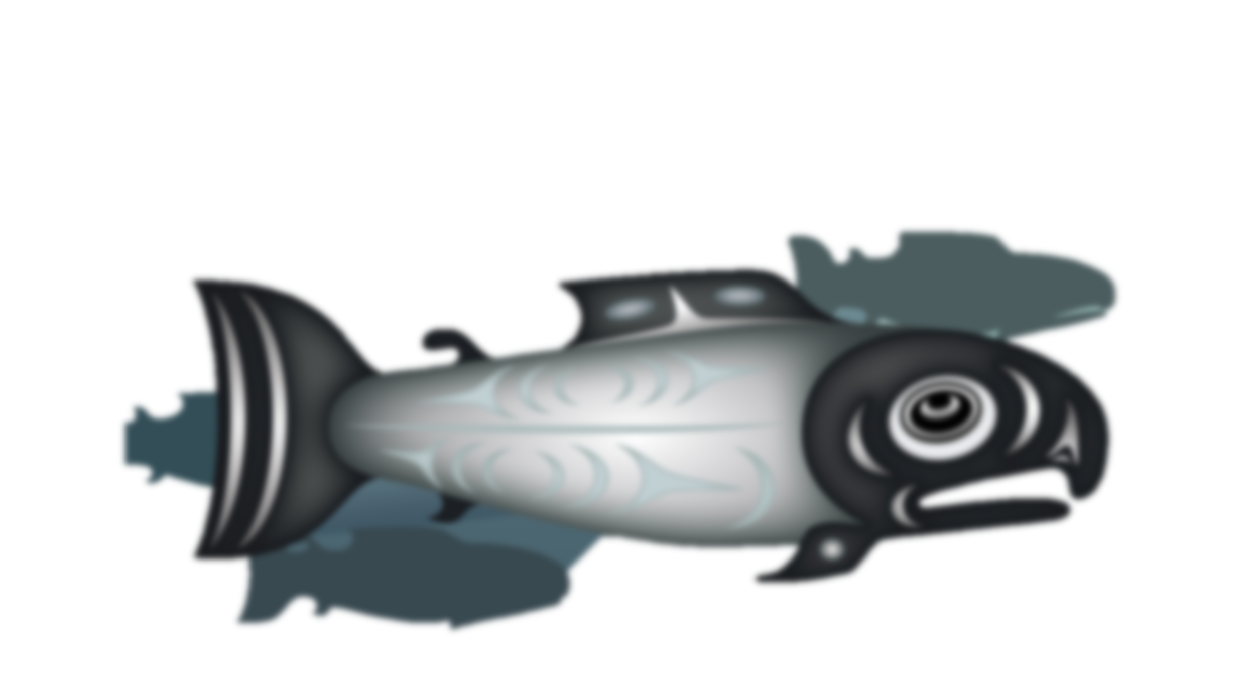
Senate bill 5433
Sec 2….when a district reviews or adopts its social studies curriculum, it shall incorporate curricula about history, culture and government of the nearest federally recognized Indian tribe or tribes, so that students can learn about the unique heritage and experience of their closest neighbor.

Slide 9
STI Tribal Sovereignty Early Learning curriculum overview
Three lessons designed for Pre K developmental and experiential learning
Lessons are aligned to Washington State Early Learning & Development Guidelines and the current 3rd – 12th grade STI curriculum www.indian-ed.org
This curriculum is a free, ready to use, resource available to all educators across the state and will be online

Slide 10
Who We Are
Exploration of family & cultural identity through a storybook, discussions, family participation, and a collage project. Recognizing place and the history of Native families and tribes since time immemorial.
House of Salmon
Exploration of the historic & contemporary significance of salmon and our shared ecosystem through a story book, discussions, & ecological play.
Respecting Our House
Exploration of cause and effect of human impact on environment through traditional story, discussions, and science experiment. Exploration of the importance of place and the role we play in the health of our shared home with all living things.

Slide 11
Guiding principles
Introduction to concepts of tribal sovereignty.
Includes real life, sometimes controversial issues.
Connect the heart, head, and hands for whole child learning.
Recognize that culture is dynamic and always evolving.
Stress the resiliency of Native cultures, and true histories despite intentional oppression and genocide.
Emphasize that co-responsibility for change involves developing allies who know how to take action.
Nurture the seeds of inquiry in early learners that will grow throughout their educational journey.

Slide 12
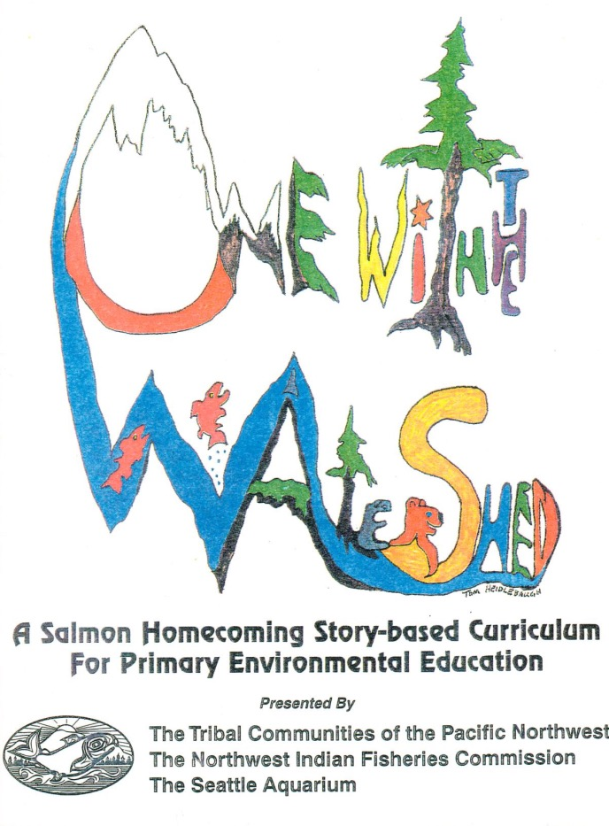
Story Based
All lessons are Native authored storybook or traditional oral story based

Slide 13
How & why we chose this literature
Focuses on Indigenous nations whose territories are in Washington State and are land based
Native authored and or created through tribal partnerships
Oyate – www.oyate.org
How to Tell the Difference: A Guide for Evaluating Children’s books for Anti-Indian Bias

Slide 14
Curriculum structure
Lesson Plan with objectives, materials needed, vocabulary, preparation steps, and detailed instructions on how to implement
Mural project between all three lessons
Nature and Movement Extensions
Read prompt for each read of storybook or story for each lesson
Letter to Families
Centers material list & set up instructions
Word/ vocabulary and Story cards
WA State Early Learning Development Guidelines alignment
STI TS alignment

Slide 15
Classroom environment
We encourage early learning environments that are play-based with many different materials and opportunities for children to explore and to gain knowledge and skills through play.
We have incorporated several optional pieces to add to your learning spaces to give students the opportunity to make connections back to the theme(s) of the lessons and stories.

Slide 16
Suggestions for LEARNING AREAS
Writing: Vocabulary cards
Science: Salmon Life Cycle materials, healthy river/ watershed habitat organic materials & Non-fiction books
Block: Community Blocks representing the Indigenous community you are teaching about or are in, Maps of tribes of Washington or of community
Housekeeping: Fishing nets, felt salmon to cook, woven baskets
Manipulatives: Salmon Life Cycle Sequencing, Types of PNW Salmon Bingo Memory Game
Doll House/ Imaginative Play: Small sized salmon drying racks, small felt salmon, Native American doll figurines (contemporary models, non stereotypical)
Reading: A River Lost story retelling rocks, Native American storybook collection, Native Newspapers, Story cards, Non-fiction books about the theme(s)

Slide 17
Who we are – lesson one
Lesson Plan: objectives, materials needed, vocabulary, preparation steps, detailed instructions on how to implement
Nature and Movement Extensions
1st Read & template
Letter to Families
Word/ vocabulary cards
Story cards
Exploration of family & cultural identity through a storybook, discussions, family participation, and a collage project. Recognizing place and the history of Native families and tribes since time immemorial.

Slide 18
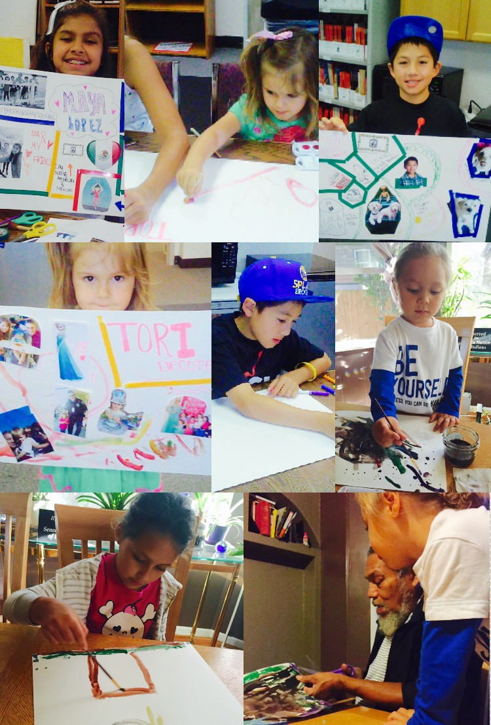
who we are collages
How might having a collage representing a child, their family, culture, and values be important in your classroom?

Slide 19
The house of salmon – lesson two
Lesson Plan: objectives, materials needed, vocabulary, preparation steps, detailed instructions on how to implement
Nature, Movement and Mural Extensions
2nd Read & template
Letter to Families
Word/ vocabulary cards
Story cards
Exploration of the historic & contemporary significance of salmon and our shared ecosystem through a story book, discussions, & ecological play

Slide 20
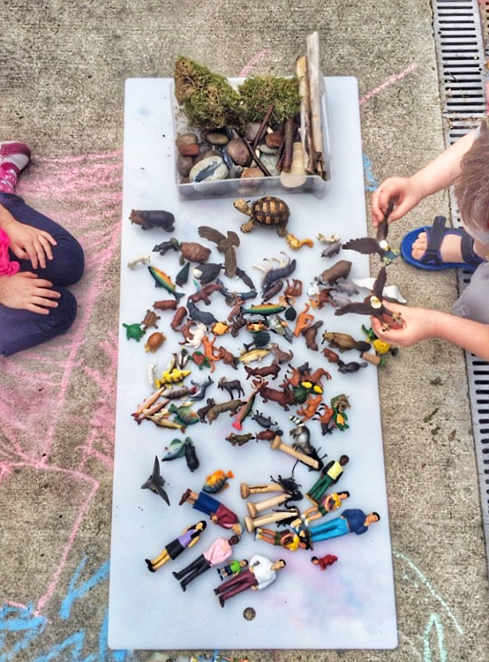
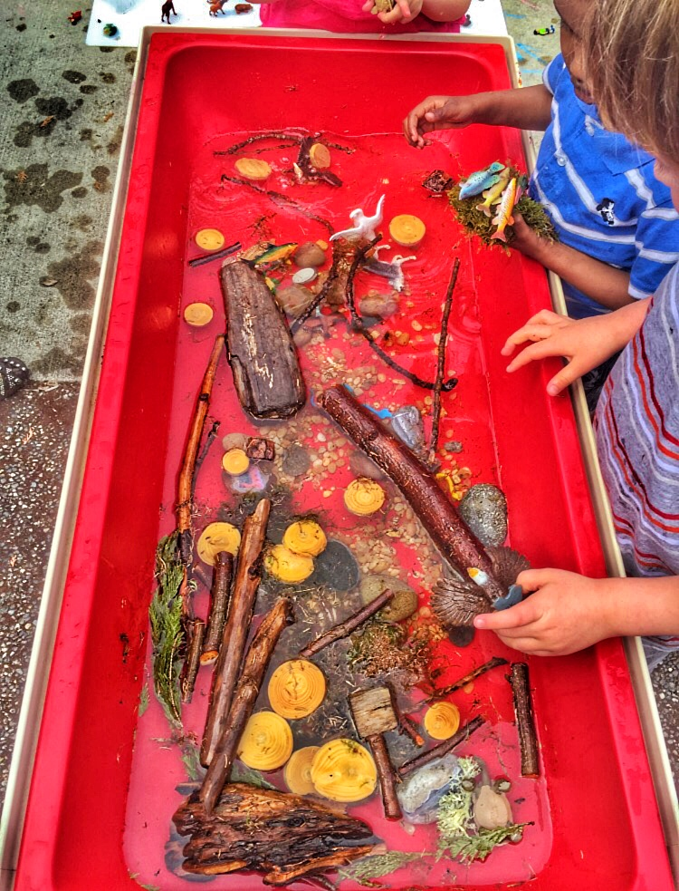
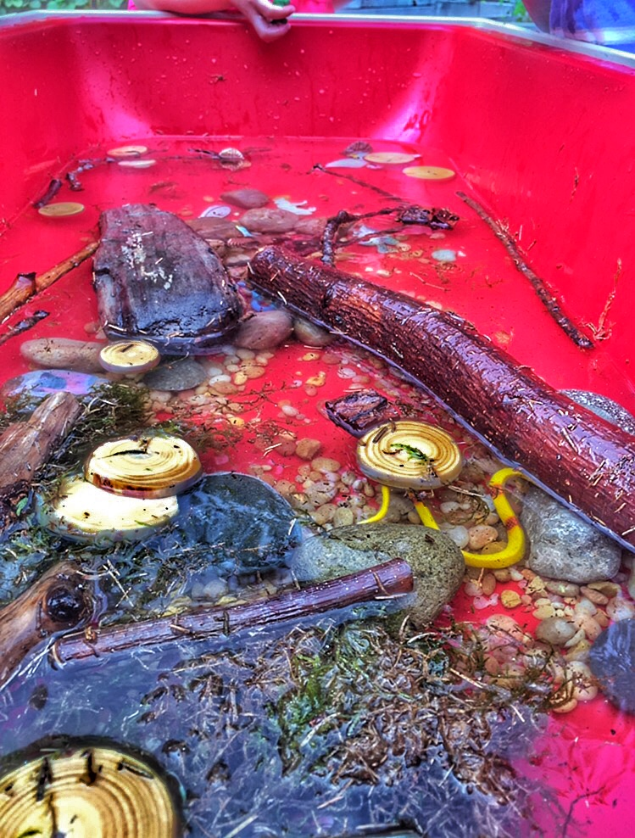

Slide 21
Note on ecological play
Excerpts from Dr. Megan Bang’s work on Ecological Play with Dioramas:
Talk – Means narrating or telling a story. It also means asking questions and wondering about things to explore the forest ecosystem model you are playing with
Action – Means being intentional about trying to approximate real behaviors and movements with your focal animal in the diorama model
Content – means the spread of information about the natural work that you are facilitating attention to during play

Slide 22
Respecting our house – lesson three
Lesson Plan: objectives, materials needed, vocabulary, preparation steps, detailed instructions on how to implement
Nature, Movement, and Mural Extensions
Vocabulary and Discussion
Letter to Families
Word/ vocabulary cards
Story cards
Exploration of
cause and effect of human impact on environment through traditional story, discussions, and science experiment. Exploration of the importance of place and the role we play in the health of our shared home with
all living things

Slide 23
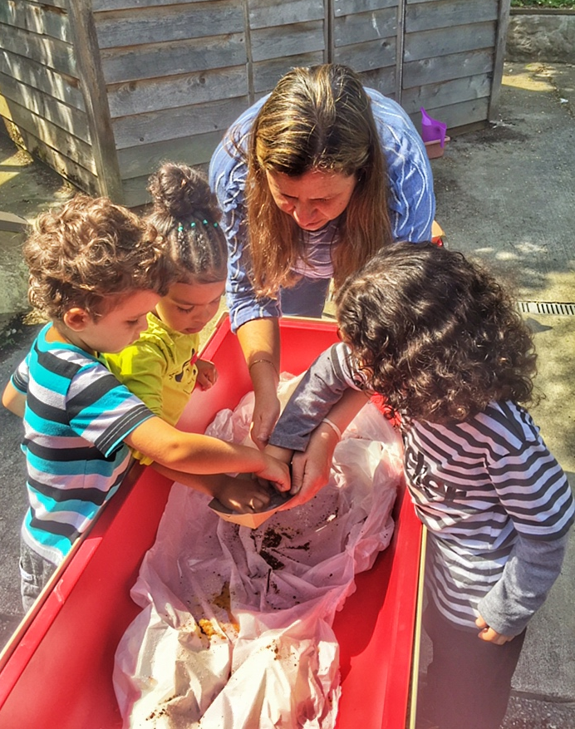
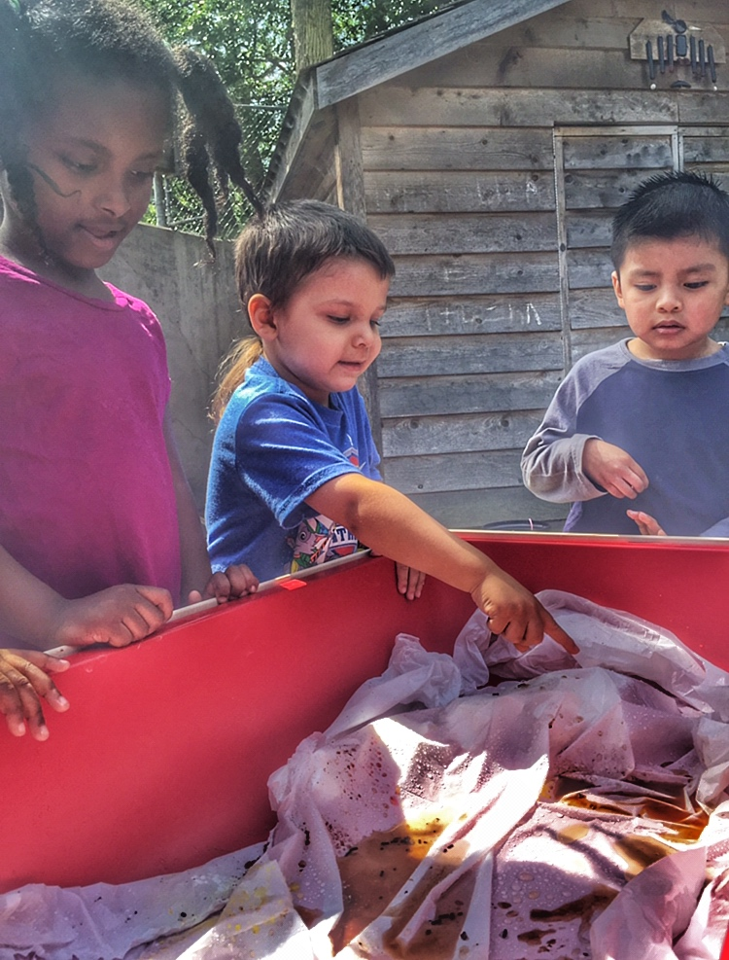
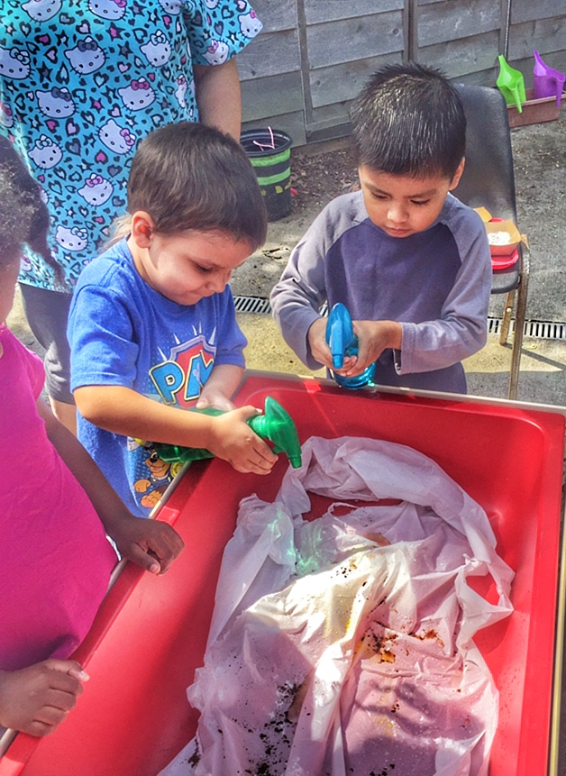

Slide 24
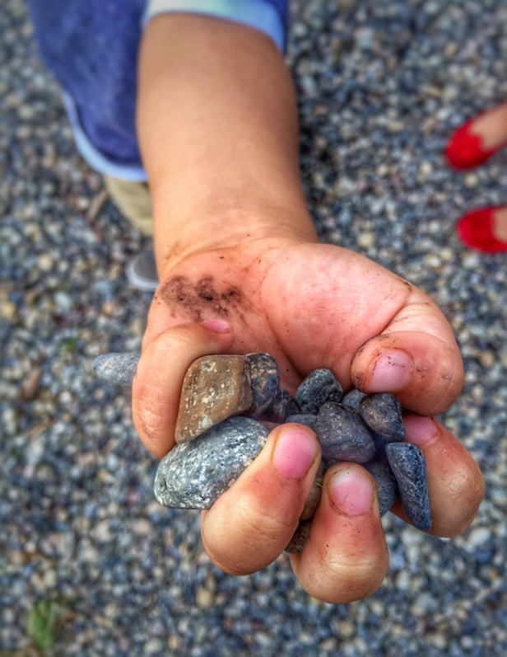
Lesson breakout
Split into three groups at the three different tables or water tables
Read through the lesson plan as a group and then decide who will facilitate which piece of the lesson
Engage with the lesson as if you were a group of students with one educator facilitating

Slide 25
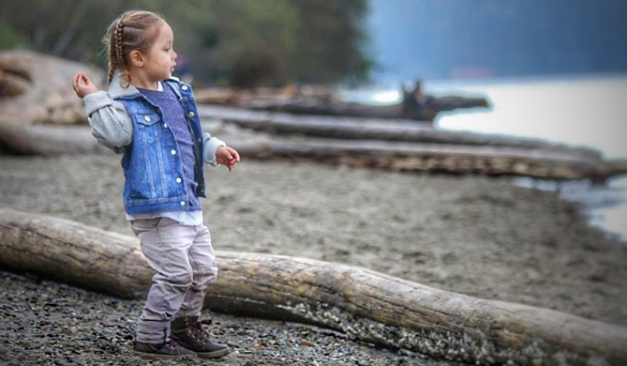
Think about how these lessons will work in your classrooms:
How might you need to adapt the lessons?
What aspect are you most excited to try?
What might be a challenge for you to implement the lessons?
How might you grow the lesson(s)?

Slide 26
Please share your ideas
Print provided by Qwalsius Shaun Peterson, Puyallup
Contact info

Slide 27
Indian education today
Indian education dates back to a time when all children were identified as gifted and talented. Each child had a skill and ability that would contribute to the health and vitality of the community. Everyone in the community helped to identify and cultivate these skills and abilities. The elders were entrusted to oversee this sacred act of knowledge being shared. That is our vision for Indian education today.
- FromWhere the Sun Rises

Slide 28
Thank you so much for your creativity and commitment!
STI ELC Development Team
Rebecca Kreth - rckreth@yahoo.com
Elaine Grinnell, Jamestown S’Klallam Tribe
Amanda Rambayan – adecoteau@hotmail.com
Sarah Stafford – sarahj_mc@yahoo.com
Dr. Laura Lynn – llynn2020@gmail.com
PSESD - www.psesd.org
First Peoples First Steps Alliance & Thrive WA Dan Torres- dan@thrivewa.org
www.thrivewa.org
Shaun Peterson – www.qwalsius.com
t – 206.906.8029
OSPI Office of Native Education –
Michael Vendiola – Michael.vendiola@k12.wa.us
Joan Banker – joan.banker@k12.wa.us
DEL Tribal Liaison
Tleena Ives – tleena.ives@del.wa.gov

